Slide 1
Definitions
Faith for Rights Module 4

Slide 2
State Actor
An organization and/or individual that
is affiliated with, directed by, or funded
through the government.
https://www.escr-net.org/resources/non-state-actors#:~:text=%2D%2DPreamble%20to%20the%20Universal,or%20funded%20through%20the%20government

Slide 3
Secularism
State actors having no express
common religion.
https://www.un.org/sg/en/content/sg/speeches/2009-11-03/speech-summit-religious-and-secular-leaders-climate-change#:~:text=As%20a%20secular%20organization%2C%20the,inherent%20dignity%20of%20all%20individuals

Slide 4
Neutrality
The quality or state of being neutral;
impartiality towards others.
https://www.un.org/en/observances/neutrality-day#:~:text=Neutrality%20%E2%80%94%20defined%20as%20the%20legal,is%20critically%20important%20for%20the
https://www.merriam-webster.com/dictionary/neutrality

Slide 5
Passivity
The quality or state of being passive;
tending not to take an active or
dominant part.
https://www.merriam-webster.com/dictionary/passive

Slide 6
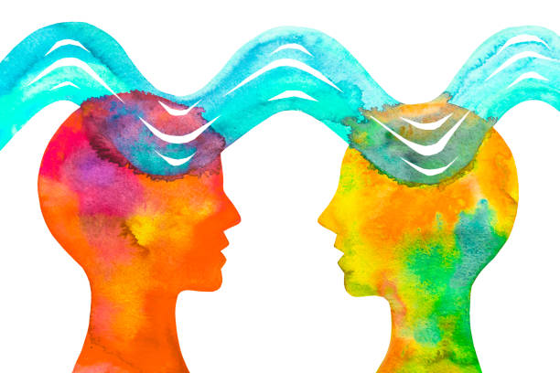
Religious Pluralism
The state of being where every
individual in a religiously diverse
society has the rights, freedoms, and
safety to worship, or not, according to
their conscience.
https://www.aspeninstitute.org/blog-posts/religious-pluralism-101/

Slide 7
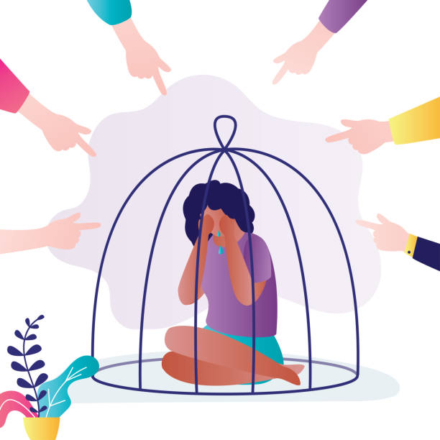
Discrimination
A prejudiced or prejudicial outlook, action, or treatment.
https://www.merriam-webster.com/dictionary/discrimination

