Slide 1
Incitement to Hatred
Artistic Expression Activity
Module 7

Slide 2
Commitment VII
We pledge to publicly denounce all instances of advocacy of hatred that incites to violence, discrimination or hostility, including those that lead to atrocity crimes. We bear a direct responsibility to denounce such advocacy, particularly when it is conducted in the name of religion or belief.
What artistic expressions do you know of that capture aspects of Commitment VII? Ponder this question as you view the following examples

Slide 3
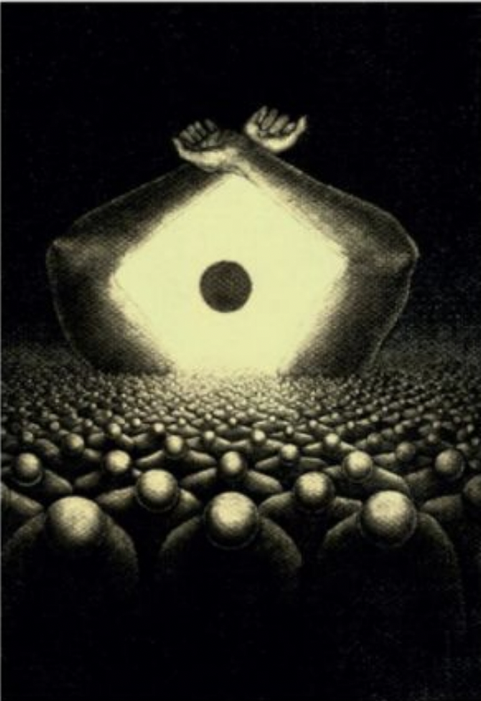
Cartoon representing Article 4 of the Universal Declaration of Human Rights, Freedom from Slavery.
Submitted in a contest held by the UNHRC and the Cartoon Movement to celebrate the 70th anniversary of the Universal Declaration of
Human Rights. Cartoons representing the other articles of the Universal Declaration can be found here.

Slide 4
Calligraphy Representing Commitment VII on Faith for Rights.
Calligraphy of other commitments found here.

Slide 5
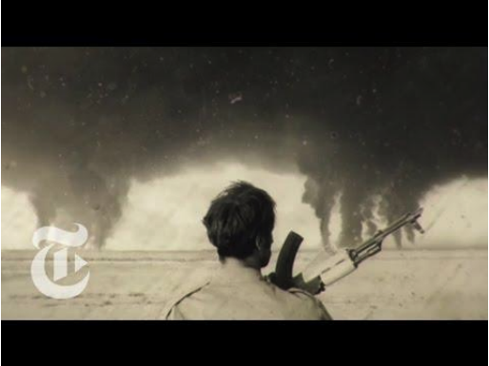
My Enemy, My Brother
Produced by Ann Shin for The New York Times, Op-Docs

Slide 6
Music
https://soundcloud.com/faith4rights/commitment7

Slide 7
Consider
• How can artwork speak out against violence, discrimination or hostility?
• How can artwork inspire others to show dignity and equality?
• How can art communicate about sensitive issues related to
discimination when words cannot?
• What artistic expressions can you think of that capture aspects of Commitment VII?

