Slide 1
Thinking Critically about Commitment V
F4R Module 5: Women, Girls, and Gender Equality

Slide 2
Do you disagree with some or all of the elements of Commitment V?
Can these elements be addressed separately?
Are there elements missing from Commitment V that could improve our fight against gender discrimination?

Slide 3
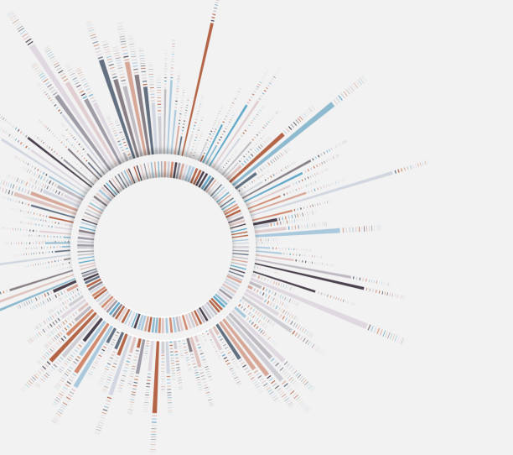
Are there women religious leaders in your environment? If not, why not?
What are the obstacles of having more women with responsibilities within the religious sphere?

